Slide 1
Digital Portfolio
STUDENT NAME: BHAVANA. B
REGISTER NO AND NMID: asanm11324131130500122002
DEPARTMENT: BCA
COLLEGE: 113-VALLALAR ARTS AND SCIENCE COLLEGE, VADALUR- AFFILIATED TO ANNAMALAI UNIVERSITY, CHIDAMBARAM.

Slide 2
PROJECT TITLE
Cloud - based portfolio system

Slide 3


AGENDA
Problem Statement
Project Overview
End Users
Tools and Technologies
Portfolio design and Layout
Features and Functionality
Results and Screenshots
Conclusion
Github Link
3/21/2024 Annual Review

Slide 4

PROBLEM STATEMENT
Create a cloud-based portfolio system that allows users to showcass their work, project and achievements in a easily accessible platform. The system should provife features for users.

Slide 5

PROJECT OVERVIEW
A cloud – based Portfolio system is a web
aplication that alows users to create ,
manage, and showcase their Work, projects
,and achivements in a centralized and easily
acesible platform. The system provides
features for users to customise their
portfolios, colaborate with others, and
share their work with a wider audience.

Slide 6

WHO ARE THE END USERS?
Students
Profesionals
,educators,and
recruiters who use the
smart portfolio for
showcasing skils,
evaluating talent, and
making carer or
hiring decision.

Slide 7

TOOLS AND TECHNIQUES
•Html/cs: Structuring and styling the user
interface.
•Javascript: ading interactivity and
dynamic efects.
•Botstrap or material-ui: pre-designed
ui components for faster development.
•Gogle cloud platform (gcp):suite of
cloud service for cOmputing,storage,and ml
•Cloudinary: cloud – based media management
platform for image and video procesing.

Slide 8
POTFOLIO DESIGN AND LAYOUT
.
Design:
1. Color
scheme:choose a
palette that
represents the user
brand.
2. Typography:select
fonts that are
clear,readable,and
consistent.
Layout:
1. Grid-based:organize
content into a grid
structure for a clean
and structured look.
2. Masonry:use a
masonry layout for a
more dynamic and
visually intersting
display.
8

Slide 9
FEATURES AND FUNCTIONALITY
1. Portfolio creation : Users can create a
customized their portfolios with various content
types.
2. Drag-and drop editor: easy-to- use editor for
arranging content.
3. User profiles: users can create and manage
their profiles.
4. Secruity: secure authentication,
Authorization,and date storage.

Slide 10
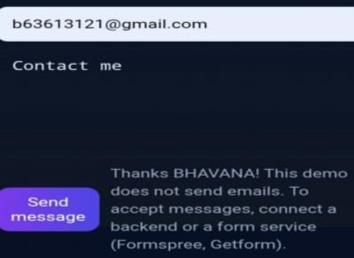

RESULTS AND SCREENSHOTS
3/21/2024 Annual Review
10

Slide 11
CONCLUSION
By Leveraging cloud
technology and inovative
features,a cloud-based
portfolio system can help
users achieve their goals
and showcase their work
efectively.
11

